Slide 1
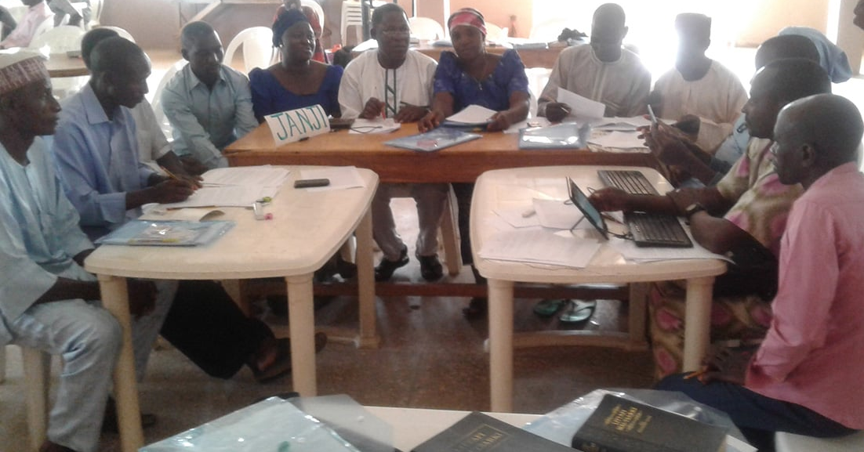
Cultural and Social Challenges

Slide 2
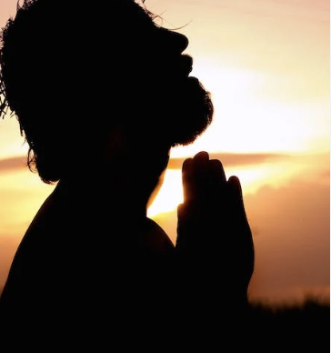
We all have Jesus
in common
Notes:
Revised 8/24/23

Slide 3
?
What differences might be challenges?

Slide 4

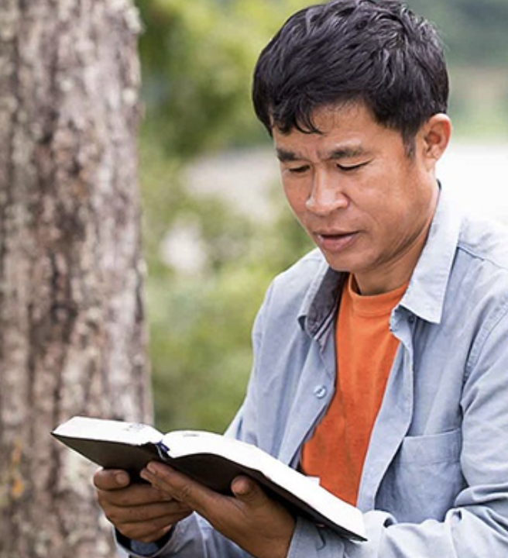

Slide 5
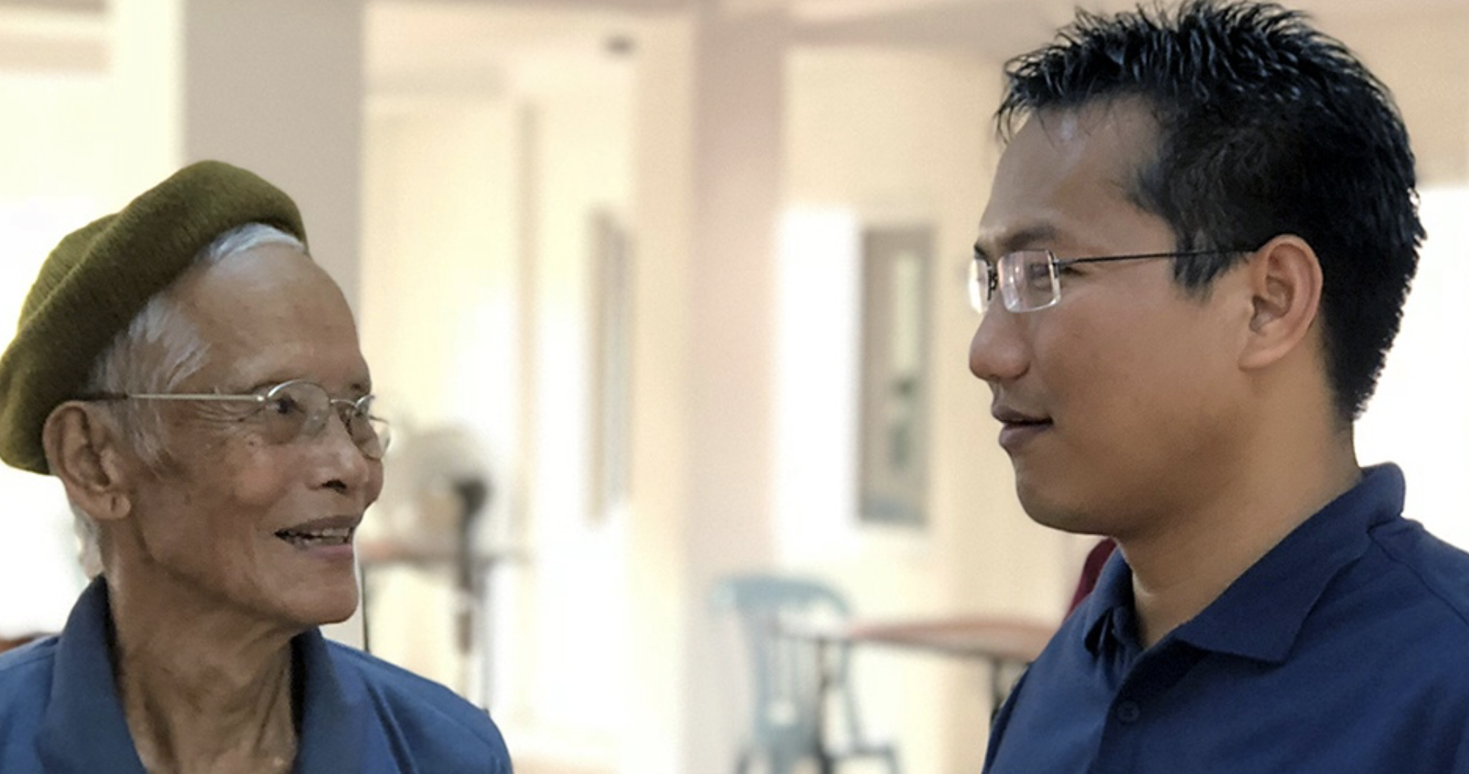
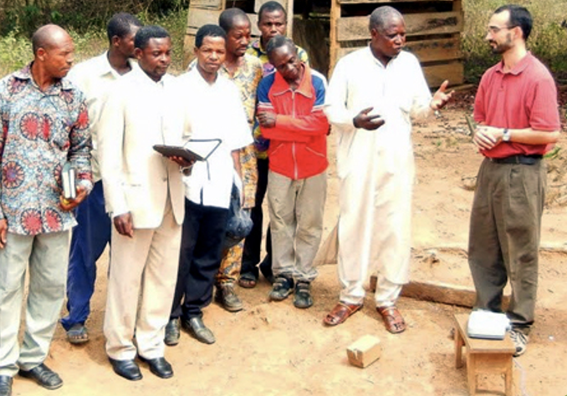
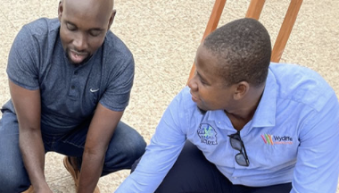
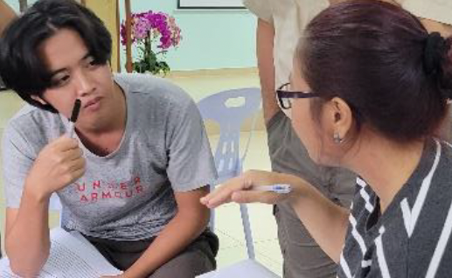
Listening to and Learning from Each Other
Connect:
Share differences.
Find similarities.

Slide 6
Try it

Slide 7
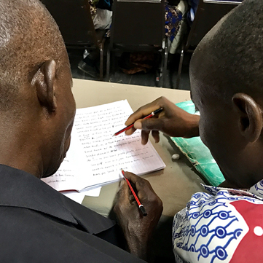
Which might cause social or cultural difficulty?
Drafting Steps
Checking Steps
Consume
Verbalize
Chunk
Blind Draft
Self-edit
Peer-edit
Keyword check
Verse-by-verse check
Ephesians 4:1⎼6

Slide 8
Review
Training and translation using the MAST steps and method may be
Counter-cultural
Uncomfortable
What should you do?

Slide 9


